Slide 1
SE-3002 Software Quality Engineering
Lecture 3-chapter 1
Overview and Basics
Alina Arshad
alina.arshad@nu.edu.pk

Slide 2
Roles & responsibilities of SQA team
Review of documents developed by development team
Track the compliance with standards
Development of QA Plan (test plan + test cases)
Implementation of test cases (Black Box or Glass Box Testing)
Management of bug repository
Participating in code and design reviews
Participate in product and process audits.

Slide 3
Roles & responsibilities of SQA team
Responsibilities of a tester
Design test cases
Write test scripts
Execute test cases
Responsibility of SQA manager
Give 25% time for reviewing test cases written
Lead review meetings
Resolve conflicts

Slide 4
The characteristics of the SQA environment process
Contractual conditions
Subjection to customer-supplier relationship
Requirement for teamwork
Need for cooperation and coordination with other development teams
Need for interfaces with other software systems
Need to continue carrying out a project while the team changes
Need to continue maintaining the software system for years

Slide 5
The characteristics of the SQA environment process
Contractual Conditions
As a result of the commitments and conditions defined in the contract between the software developer and the customer, the activities of software development and maintenance need to cope with:
A defined list of functional requirements that the developed software and its maintenance need to fulfill.
Subjection to customer-supplier relationship
Continuous cooperation with the customer
Such relationships do not usually exist when software is developed by non-software professionals

Slide 6
The characteristics of the SQA environment process
Requirement for teamwork
The following factors usually motivate the establishment of a project team rather than assigning the project to one professional
The desire to benefit from professionals’ mutual support and review for the enhancement of project quality.
Cooperation and coordination with other development teams
Cooperation may be required with:
Other software development teams

Slide 7
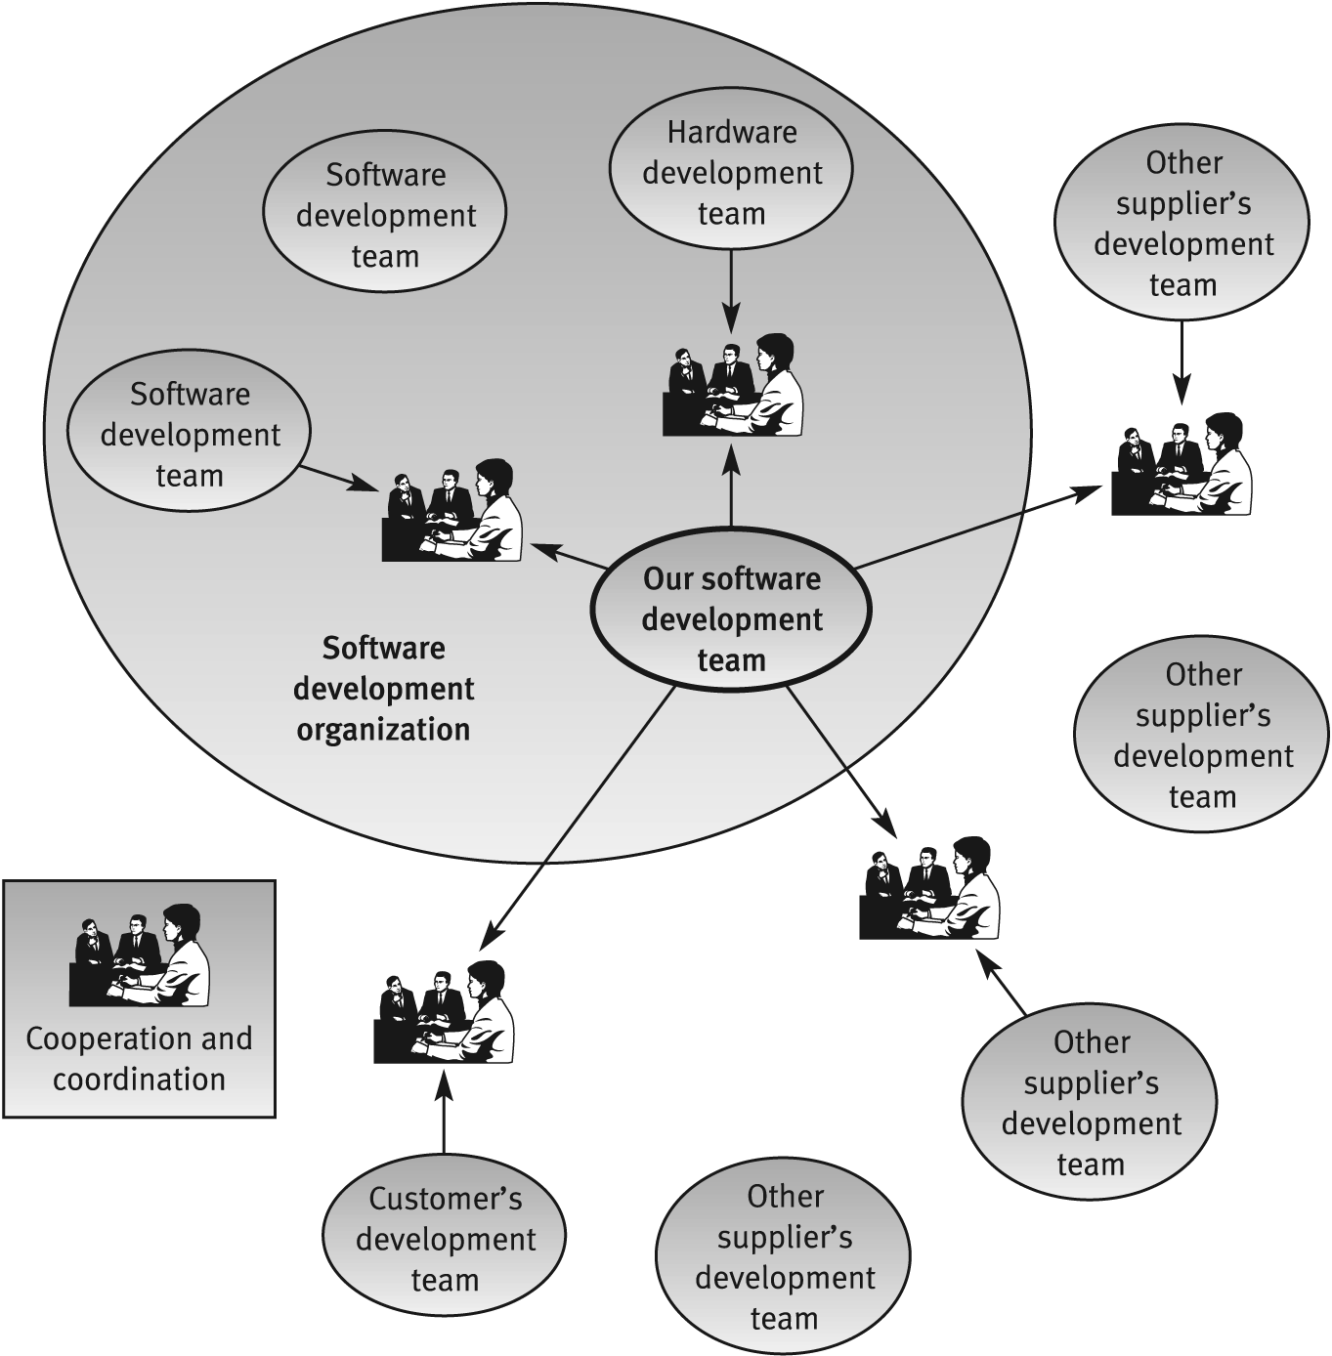
Cooperation and coordination scheme for a software development project team

Slide 8
The characteristics of the SQA environment process
Interfaces with other software systems
Need to continue carrying out a project while the team changes
It is quite common for team members to leave the team during the project development period. The team leader then has to replace the departing team member either by another employee or by a newly recruited employee.
Need to continue maintaining the software system for years
Customers who develop or purchase a software system expect to continue utilizing it for a long period, usually for 5–10 years. During the service period, the need for maintenance will eventually arise. In most cases, the developer is required to supply these services directly.

Slide 9
The salary software system – an example of software interfaces

Slide 10
People’s Roles and Responsibilities
About software quality, people may have different views and expectations based on their roles and responsibilities
Mainly two groups:
Consumers of software products and services
Customers, users, non-human users (other systems)
Producers of software products and services
anyone involved with the development, management, maintenance, marketing, and service of software products

Slide 11
Quality Attributes
Quality attributes apply both to the product and the process.
Product: delivered to the customer
Process: produces the software product
Resources: (both the product and the process require resources)
Underlying assumption: a quality process leads to a quality product

Slide 12
Quality Attributes
Quality attributes can be external or internal.
External: Derived from the relationship between the environment and the system (or the process). (To derive, the system or process must run)
e.g. Reliability, Robustness
Internal: Derived immediately from the product or process description (To derive, it is sufficient to have the description)
Underlying assumption: internal quality leads to external quality (cfr. metaphor manufacturing lines)
e.g. Efficiency

Slide 13
Defects in the context of QA and quality engineering
Three generic ways to deal with defects include:
defect prevention
defect detection and removal
defect containment
Quality engineering can also be viewed as defect management. In addition to the execution of the planned QA activities, quality engineering also includes:
quality planning before specific QA activities are carried out
measurement, analysis, and feedback to monitor and control the QA activities

Slide 14
Causes of Software Errors
Faulty definition of requirements
Client-developer communication failures
Deliberate deviation from requirements
Logical design errors/Coding errors
Non-compliance with documentation and coding instructions
Shortcomings of the testing process
Procedure errors
Documentation errors
Omission of software functions

Slide 15
Any question????

